Slide 1


MALINENI LAKSHMAIAH WOMEN’S ENGINEERING COLLEGE (Accredited by NBA(CSE&ECE),NAAC A+,Approved by AICTE,NEW DELHI,Afficated to JNTUK,Kakinada)
MOBILE PRICE CLASSIFICATION
UNDER THE GUIDANCE OF :
A.RamaKrishna, M.Tech .
TEAM MEMBERS :
N.LAKSHMI PRASANNA(20KE1A1244)
K.LAKSHMI TRIPURA(20KE1A1228)
G.SAHITHI PRATHUSHA(20KE1A1222)
M.SANDHYA(20KE1A1236)

Slide 2

MOBILE PRICE CLASSIFICATION USING MACHINE LEARNING

Slide 3

CONTENTS
ABSTRACT
INTRODUCTION
EXISTING SYSTEM
PROPOSED SYSTEM
SYSTEM REQUIREMENTS
DESIGN
ACHIEVED RESULT
CONCLUSION
REFERENCES

Slide 4
ABSTRACT
This project aims to develop a machine learning model to predict the price range of mobile phones based on their features. Using a dataset from Kaggle, we trained various classification algorithms to identify the most accurate model for price prediction. The project utilizes Python and its powerful ML libraries for model development and Streamlit for a user-friendly web interface. Users can input mobile specifications such as battery power, Bluetooth, clock speed, RAM, and more to obtain a predicted price range—low, medium, or high. This tool can assist manufacturers in pricing strategies and help consumers make informed purchasing decisions. The project demonstrates the practical application of predictive analytics in addressing real-world problems.

Slide 5
INTRODUCTION
In today's digital age, mobile phones have become indispensable tools for communication, entertainment, and productivity, making the mobile phone market highly dynamic with frequent releases of new models.
Determining the optimal price of a mobile phone based on its features poses a significant challenge for both consumers and manufacturers. Consumers often struggle to correlate specifications with the price, leading to potential misjudgments in value.
This project aims to develop a machine learning model to predict the price range of mobile phones based on these specifications and identify the most accurate algorithm for this task. By providing insights into mobile pricing, this tool will assist consumers in making informed purchasing decisions and help manufacturers set competitive prices, contributing to the field of predictive analytics.

Slide 6
EXISTING SYSTEM
Current methods for mobile price estimation often rely on manual analysis or simplistic pricing strategies that do not account for the multitude of features modern smartphones possess. These methods are time-consuming and prone to inaccuracies, failing to provide a reliable pricing strategy in a dynamic market
The existing system for mobile price estimation faces limitations due to its reliance on manual analysis or simplistic pricing strategies. These methods often overlook the diverse array of features modern smartphones possess, leading to inaccuracies in price prediction. Moreover, the current approach typically utilizes traditional statistical methods or basic machine learning algorithms, which may lack the sophistication needed to capture the complexities of the mobile phone market. As a result, prediction models trained on these methods may struggle to provide precise price estimates. Additionally, the evaluation of these models is based on standard metrics like accuracy and precision, which may not fully reflect their performance in real-world scenarios.

Slide 7
DISADVANTAGES :
Neglects Non-Price Factors: Focuses solely on price, disregarding other important aspects such as performance, durability, and user experience.
Inaccuracy: Manual and simplistic methods do not consider all relevant features, leading to inaccurate pricing.
Time-Consuming: Analyzing and estimating prices manually is a slow process.
Lack of Adaptability: Existing methods do not adapt well to the rapid technological advancements in the mobile industry.

Slide 8
PROPOSED SYSTEM
Our proposed system utilizes machine learning algorithms to predict mobile phone price ranges based on key features such as battery power, RAM, internal memory, and more. By training models on historical data, we can provide accurate and automated price predictions. The system features a user-friendly interface built with Streamlit, allowing users to input mobile specifications and receive instant price range predictions.
Additionally, our system employs multiple machine learning models to ensure robust performance and accuracy. We experiment with various algorithms including Logistic Regression, K-Nearest Neighbors (KNN), Decision Tree, and Random Forest. Each model is trained and evaluated using metrics like accuracy score and confusion matrix to identify the best-performing approach. This enhances the system's predictive capability, ensuring reliable and up-to-date price range predictions, and provides a competitive edge with dynamic, data-driven pricing strategies.

Slide 9
ADVANTAGES:
Accuracy: Machine learning models provide more accurate price predictions by considering a wide range of features.
Efficiency: Automated predictions save time compared to manual methods.
User-Friendly: The Streamlit interface ensures that users can easily input data and receive predictions without requiring technical expertise.
Adaptability: The system can easily be updated with new data, making it adaptable to market changes.
Algorithms:
Decision Tree, Random Forest ,Logistic Regression and KNN.

Slide 10
SYSTEM REQUIREMENTS
Hardware Requirements:
High Performance Server for Hosting
Internet Adapter : 1 Gbps
Rom : Min. 500GB SSD
Ram : 16GB+
Software Requirements:
Operating system : Windows 10.
Coding Language : Python with Jupyter.
Tool : Visual Studio Code.
Database : SQLite.

Slide 11
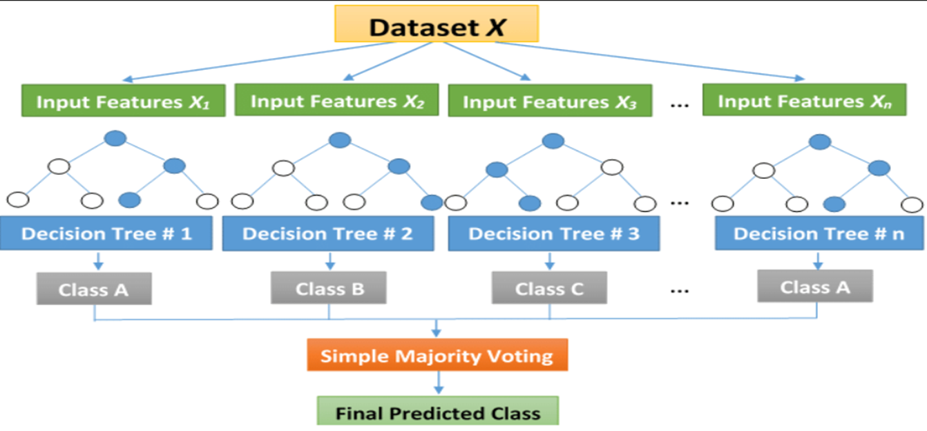
DESIGN
SYSTEM ARCHITECTURE

Slide 12
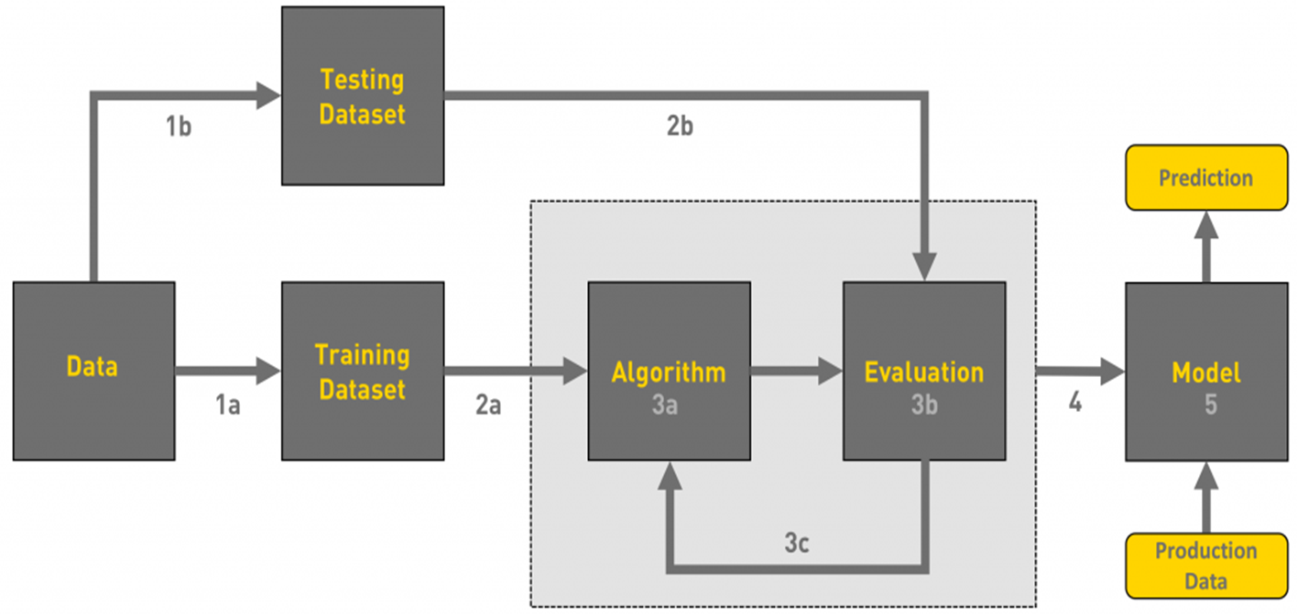
DATA FLOW DIAGRAM

Slide 13
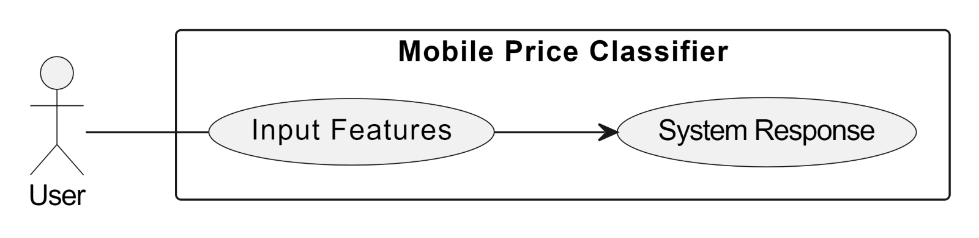
USE CASE DIAGRAM

Slide 14
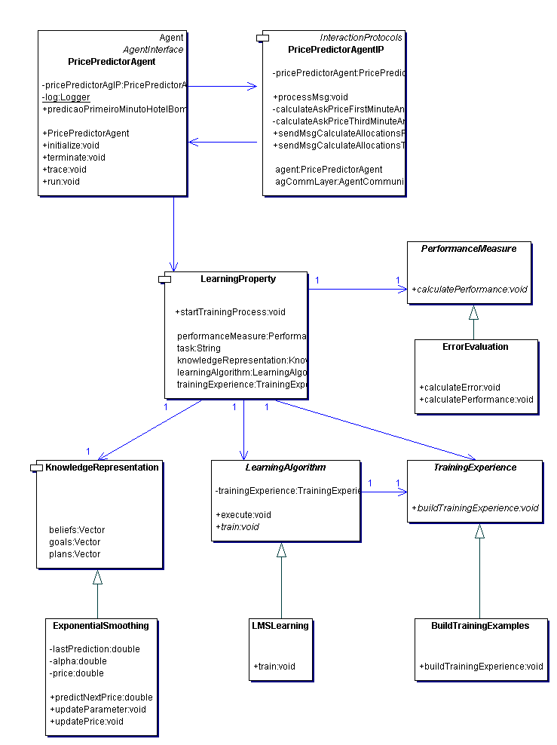
CLASS DIAGRAM

Slide 15
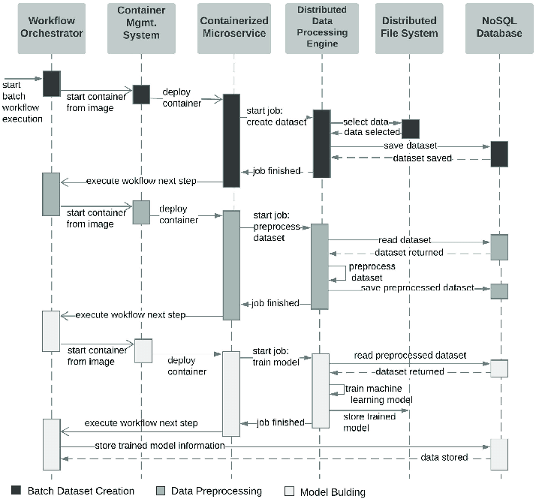
SEQUENCE DIAGRAM

Slide 16
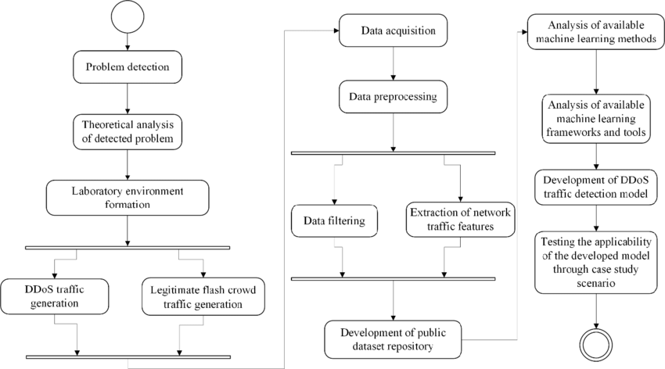
ACTIVITY DIAGRAM

Slide 17
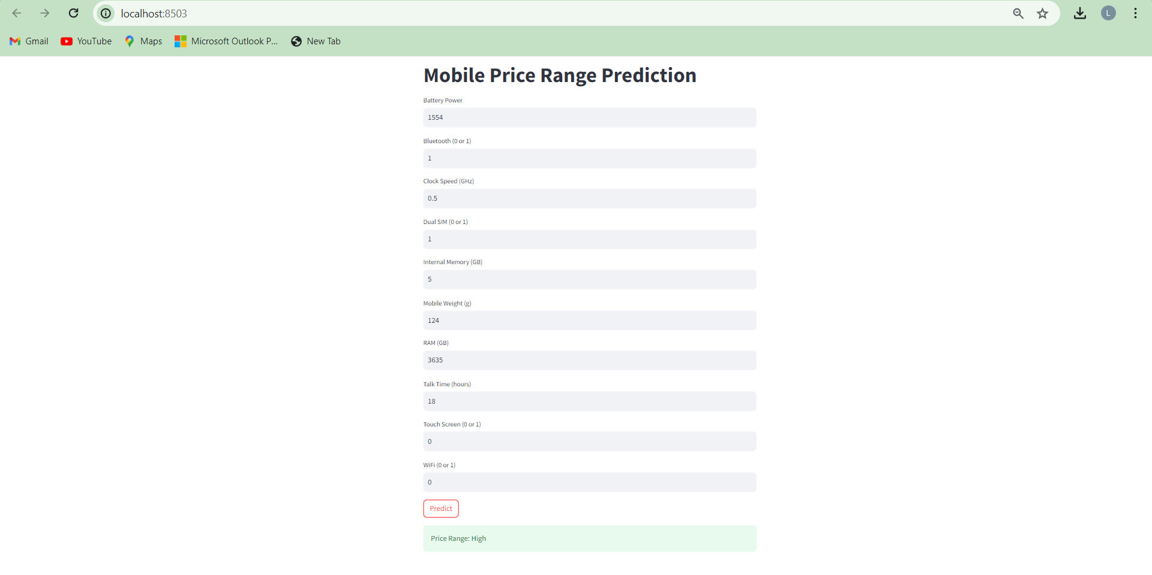
ACHIEVED RESULT
Figure : High Price WebPage

Slide 18
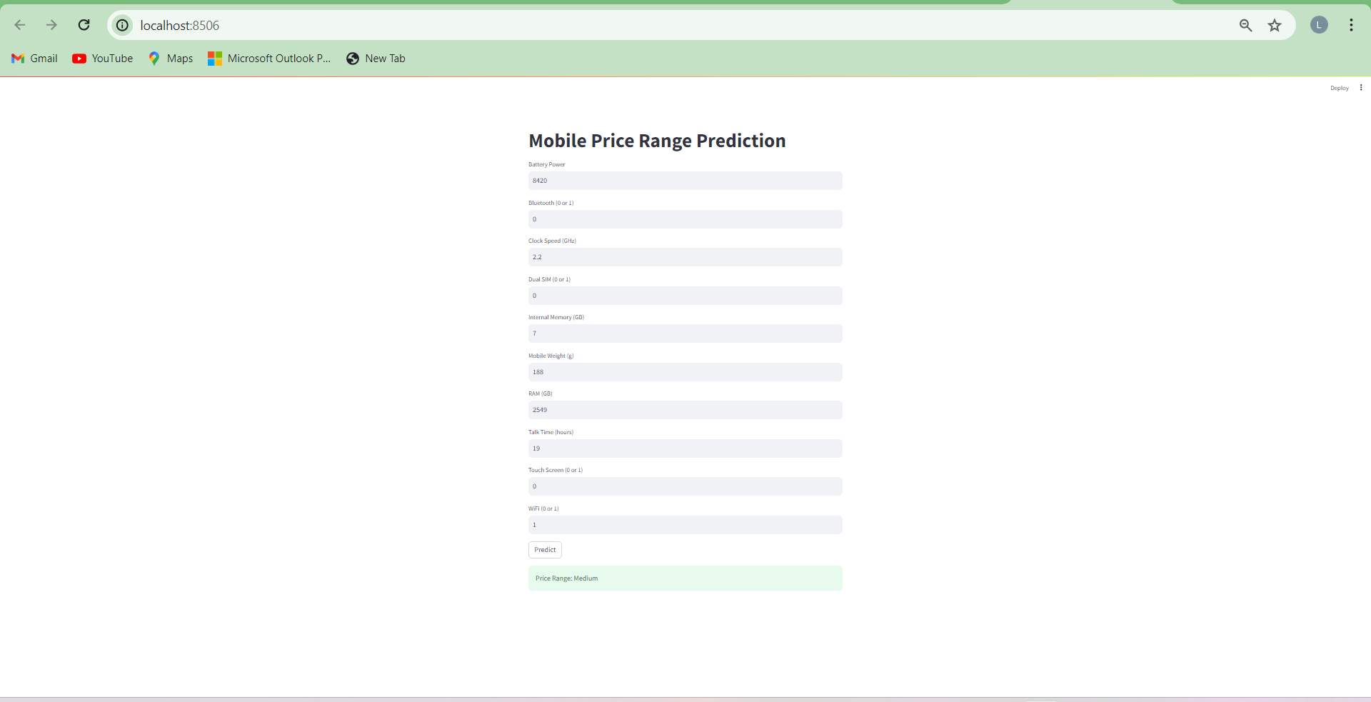
Figure : Medium Price WebPage

Slide 19
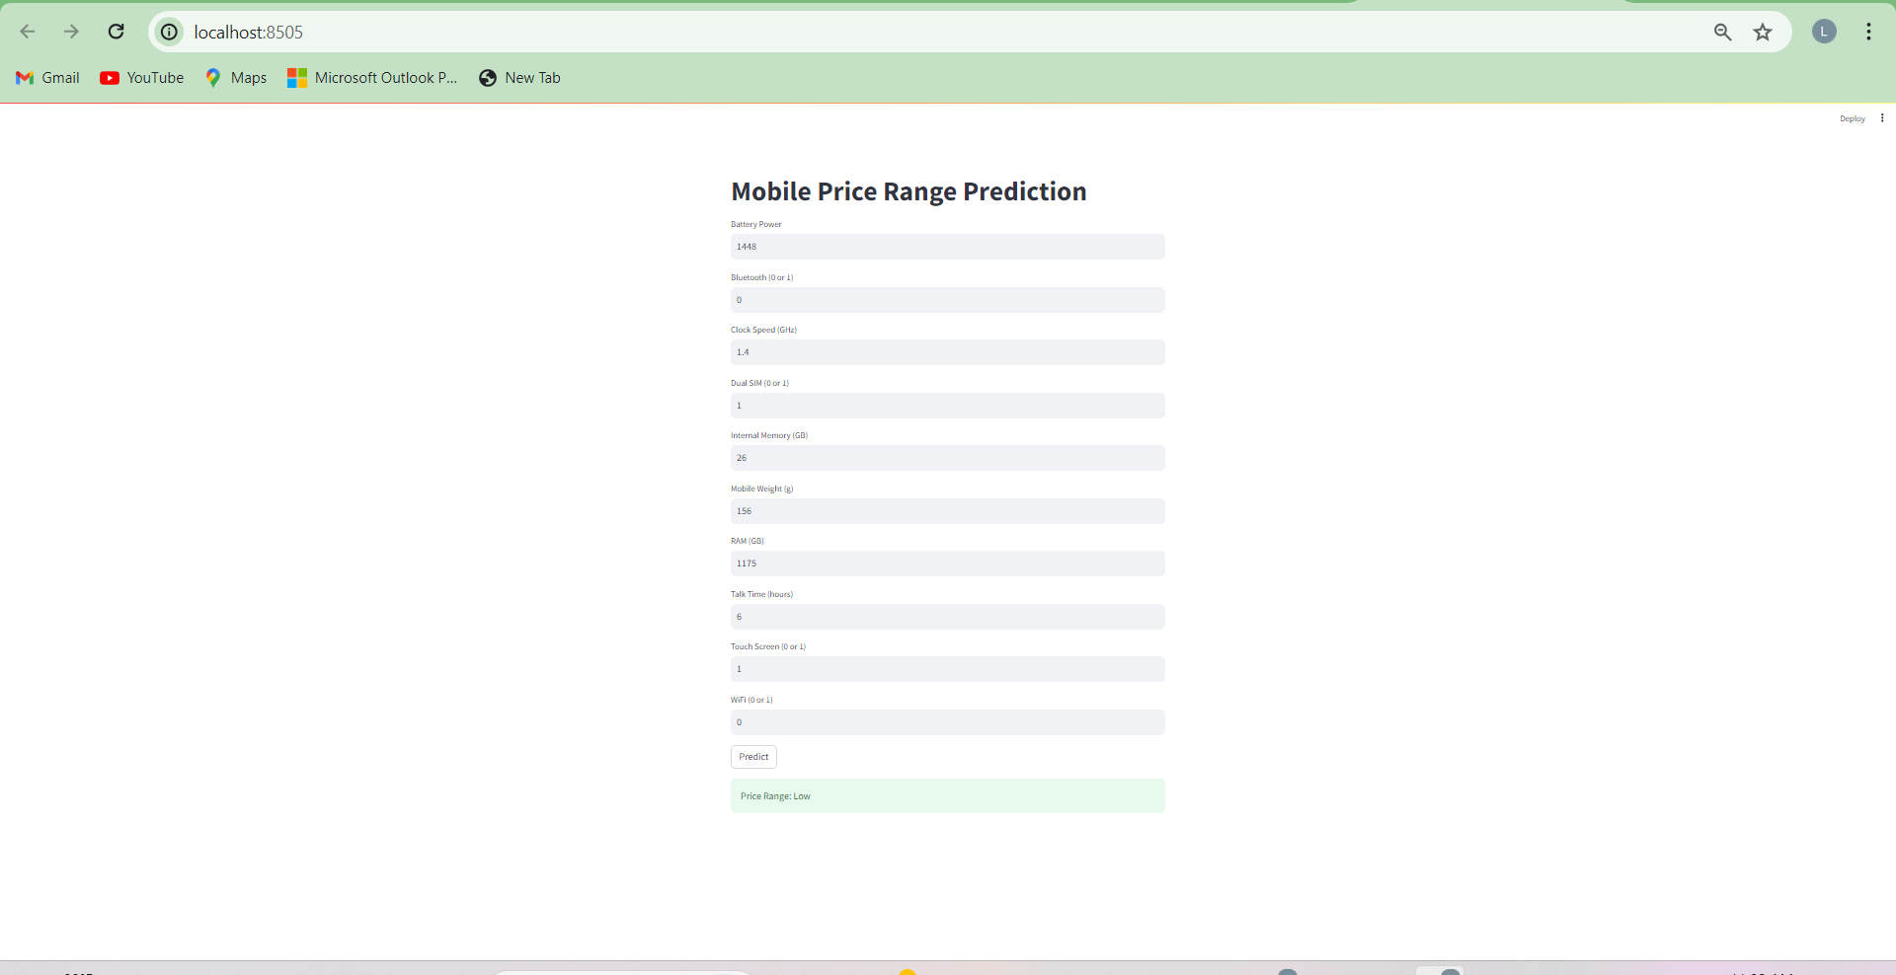
Figure : Low Price WebPage

Slide 20
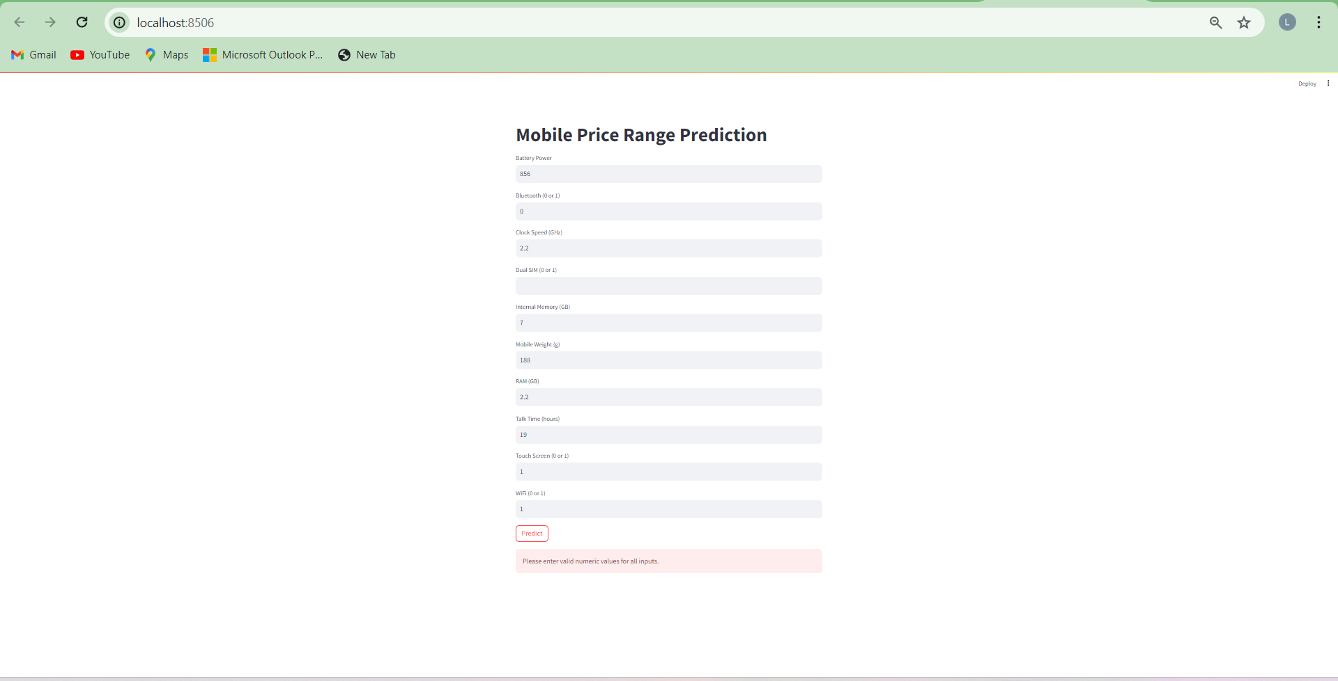
Figure : Invalid Input Error

Slide 21
CONCLUSION
The project successfully developed a machine learning model capable of predicting the price range of mobile phones based on their features. By leveraging a dataset from Kaggle and implementing various classification algorithms, we identified the most accurate model for this task. The integration of a user-friendly web interface using Stream-lit allows users to easily input mobile specifications and obtain instant price predictions. This tool can aid manufacturers in setting optimal prices and help consumers make informed purchasing decisions.

Slide 22
FURTHER ENHANCEMENT
In the future we would like to increase the accuracy and efficiency of our project by visualizing remaining errors and using further optimization techniques.
Adding more detailed features such as camera quality, brand value, and customer reviews to improve the accuracy of the predictions.
Developing a mobile application version of the tool for greater accessibility and convenience for users on the go.

Slide 23
REFERENCES
[1]. Mustafa Cetina, Yunus Koç, “Mobile Phone Price Class Prediction Using Different Classification Algorithms with Feature Selection and Parameter Optimization”, IEEE, 2021, Doi: 10.1109/ISMSIT52890.2021.9604550.
[2]. Muhammad Asim, Zafar Khan, “Mobile Price Class prediction using Machine Learning Techniques”,
[3]. International Journal of Computer Applications (0975 –8887) Volume 179 – No.29, March 2018, doi: 10.5120/ijca2018916555.
[4]. P. Arora, S. Srivastava and B. Garg, “MOBILE PRICE PREDICTION USING WEKA”, 2020.
[5]. https://www.kaggle.com/iabhishekofficial/mobile-price-prediction
[6]. https://www.gsmarena.com

Slide 24
THANK YOU

